Slide 1

SELECT
The SQL SELECT statement is used to fetch the data(records) from a database table.
The returned records are in the form of a table.
The basic syntax of SELECT is,
Here, column1, column2...are the fields of a table whose values you want to fetch.
If you want to fetch all the fields available in the table, then you can use the following syntax:

Slide 2



Consider the example that we discussed in the first slide –
Following is an example, which would fetch Sid, Name and Age fields of the above STUDENT table:
Query Result

Slide 3


If we want to fetch all the fields of STUDENT table, then we use the following query:
Query Result
The WHERE clause can be used to select specific records from the table.
We can specify a condition using comparison or logical operators like >, <, =, etc.
Query Result

Slide 4


It is important to note that all the strings should be given inside single quotes ('') where as numeric values should be given without any quote as in below example:
Query Result
AND and OR operators:
The SQL AND and OR operators are used to combine multiple conditions to narrow data in an SQL statement.
These operators enables us to make multiple comparisons with different operators in the same SQL statement.

Slide 5



The AND operator is used to combine multiple conditions in an SQL statement's WHERE clause.
The basic syntax of AND operator with WHERE clause is,
For the query to be executed, all the conditions separated by the AND must be TRUE.
For example,
Query Result

Slide 6



The OR operator is similar to AND operator but for the query to be executed, any ONE of the conditions separated by the OR must be TRUE.
The basic syntax of OR operator with WHERE clause is,
For example, consider the below query,
Query Result
We see all 3 records in the resultant table because each row has either Age = 18 or gpa > 3.5 (First 2 rows satisfies the Age = 18 condition and the last row satisfies the gpa > 3.5 condition).

Slide 7

LIKE:
SQL provides support for pattern matching through the LIKE operator.
LIKE clause is used to compare or match a value to similar values using two wildcard operators -
1) The percent sign(%)
2) The underscore(_)
The percent sign(%) represents zero, one, or multiple arbitrary characters and underscore(_) represents exactly one, arbitrary character.
These wildcard operators can be used in combinations.
The basic syntax for LIKE clause is:

Slide 8
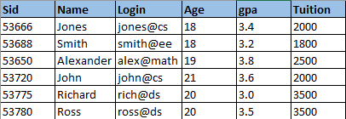
The LIKE condition can be '%XXX%' or 'XXX_' or '%XXX%' or '_XXX' or any of % and _ combinations at any place. Here XXX could be any numeric or string value.
In order to better explain the LIKE operator, let us introduce few additional records and another field to our STUDENTS table called “Tuition”, which describes the tuition paid by each student.
Our STUDENTS table would now look like,

Slide 9
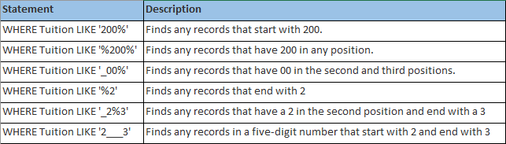
Below are few examples showing WHERE part having different LIKE clause with '%' and '_' operators:
LIKE is an extremely useful operator while searching for records in a database. Imagine a case where you need to find all the student names whose first name is John. You can use something like,
WHERE Name LIKE ‘John%’;

Slide 10




Coming back to our STUDENT table, let us consider a query which yields all the student records whose tuition starts with a 2.
Query Result
Another example can be a query which contains all student records whose Name has a ‘o’ in the second position.
Query Result

Slide 11


Let us look at few more examples with our STUDENTS table to make the concepts clear. Assume that STUDENTS table has the below information,
Find the names of all the students whose age is greater than 18 and tuition is less than 3000.
Query Result

Slide 12

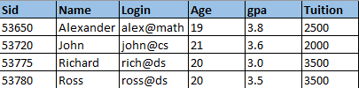


Find the student details whose gpa is greater than 3.4 or tuition greater than 3000.
Query Result
Find the student details whose name ends with an ‘s’.
Query Result

Slide 13




Find the ID, Name and Age of all the students whose name contains ‘o’ at the second position and ends with a ‘s’, or who is aged more than 20.
Query Result
Find the details of all the students whose tuition contains a ‘50’ in the value and whose gpa is 3.5 or more.
Query Result

